Slide 1
Scatter Plot Jire Dada CTEC298 Professor Bemley 5/09/2024
PowerPoint Presentation of

Slide 2
Introduction

Slide 3
Summary CTEC128
Scatter plots are not confined to one field of study. They are versatile tools that can be used in a multitude of scenarios. For instance, a human resources director may use a scatter plot to explore the connection between employees' salary and their sense of job satisfaction. After administering a job satisfaction survey, they could plot the survey results along with the salary of each participating employee and look for the connection between the two. This example showcases the versatility of scatter plots and how they can be applied in different contexts, inspiring you to explore their potential in your own field.

Slide 4
Description

Slide 5

Description of scatter plot deliverable
Drawing one by hand can help you understand how it works. To start, gather your data and record it in a two-column chart. If you want to create the scatter plot by hand, draw a graph and assign a variable to the x-axis and the y-axis. For each data set, place a dot on the spot where the two values intersect on the graph.
Heat Temperature
 | 2 |  | 1.5
 | 8 |  | 6
 | 10 |  | 7

Slide 6
Data

Slide 7
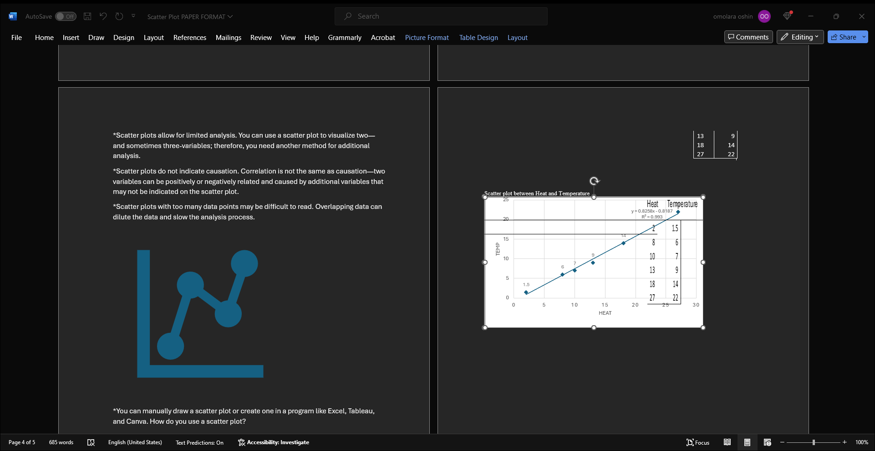
Scatter graph

Slide 8
Conclusion
A scatter graph is one of the numerous plots that can be used to represent variables visually.

Slide 9
References
https://www.coursera.org/articles/what-is-a-scatter-plot
https://www.cuemath.com/data/scatter-plot/

